Slide 1
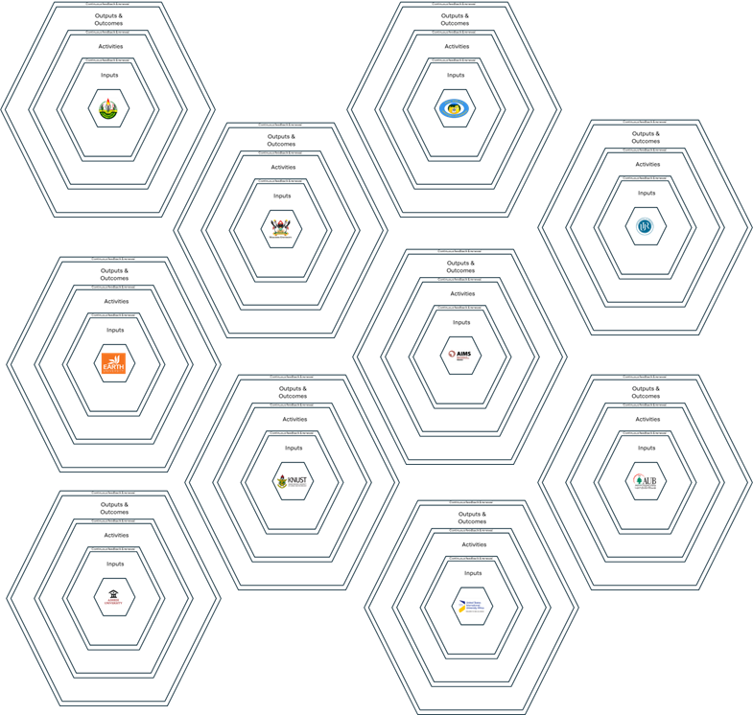

Strategy & Vision Alignment
Continuous feedback & refinement
Outputs & Outcomes
Continuous feedback & refinement
Institutionalization
Activities
Stakeholder Engagement & Ownership
Inputs
MCF funding, Scholarships, Transformation Roadmaps, Digital Transformation Experts, External funding
Data Driven Decision-Making
Transformation Workshops, Training programs (i.e. QM), Technical Consulting, Prototyping of New Digital Transformation Models
Implementation & Capacity Development
Implementation Plans (5 years), Network Collaboration, Convenings, Integration of digital strategies, Digital policy
MCF e-Learning Phase II
Theory of Transformation
Innovation & Adaption to Emerging Trends

Slide 2
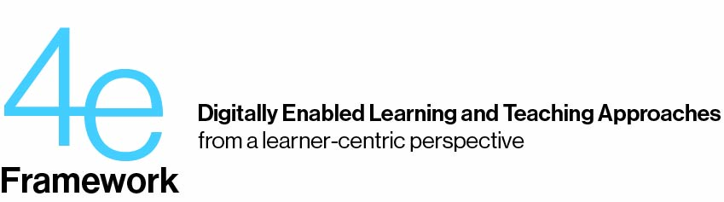
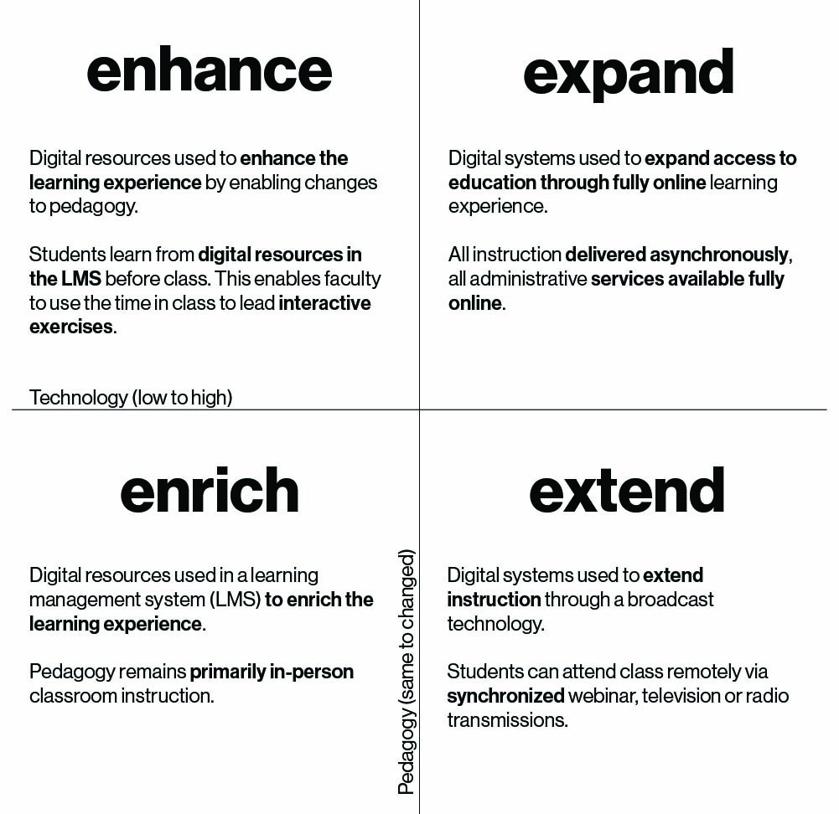
Strategy & Vision Alignment
Phase 3
Continuous feedback & refinement
Outputs & Outcomes
Institutionalization
Continuous feedback & refinement
Activities
Stakeholder Engagement & Ownership
Inputs
MCF funding, Scholarships, Transformation Roadmaps, Digital Transformation Experts, External funding
Data Driven Decision-Making
Transformation Workshops, Training programs (i.e. QM), Technical Consulting, Prototyping of New Digital Transformation Models,
Micro credentials
Implementation & Capacity Development
Implementation Plans (5 years), Network Collaboration, Convenings, Integration of digital strategies, Digital policy
MCF e-Learning Phase II
Theory of Transformation
Innovation & Adaption to Emerging Trends

