Slide 1
Portfolio Review:
Food Systems in Chicago
DECEMBER 2021

Slide 2
Table of Contents
FSIC Background
Purpose of Portfolio review
Key findings
  Implementation
  Context
  Impact (By Neighborhood)
Key INSIGHTS
Appendix

Slide 3
Background: Strategic Rationale
WHAT | Core issues
Lukas deeply cares about all people having access to nutritious, affordable food.
Research shows that better food is a means to better health.
Food access is an equity issue. It is difficult to have food aspirations when healthy food is expensive, when access is limited, and when you have not been taught about healthy food.
Solutions to better food consumption are multi-dimensional:
  Supply alone is insufficient; we must also focus on demand to increase food aspirations.
  Food access is closely tied to overall economic security; while we aren’t aiming to alleviate poverty, we must make choices that acknowledge the context of poverty.
HOW | A community-first model:
We do not have to create new programs or organizations; we can lift-up, amplify, strengthen, and connect what’s already there.
Organizations can achieve more working together than they can on their own.
Cultural competency is key to achieving our goals.
HOW | Grants first:
In place-based grantmaking, we must avoid large grants to small nonprofits that could distort the field.
Our philanthropic budget likely does not allow for large-scale investment or market shifts in access (e.g. big-box grocers).
WHERE | Geography (see geography slide):
Working at the neighborhood level makes it easier to pilot programs and see success.

Slide 4
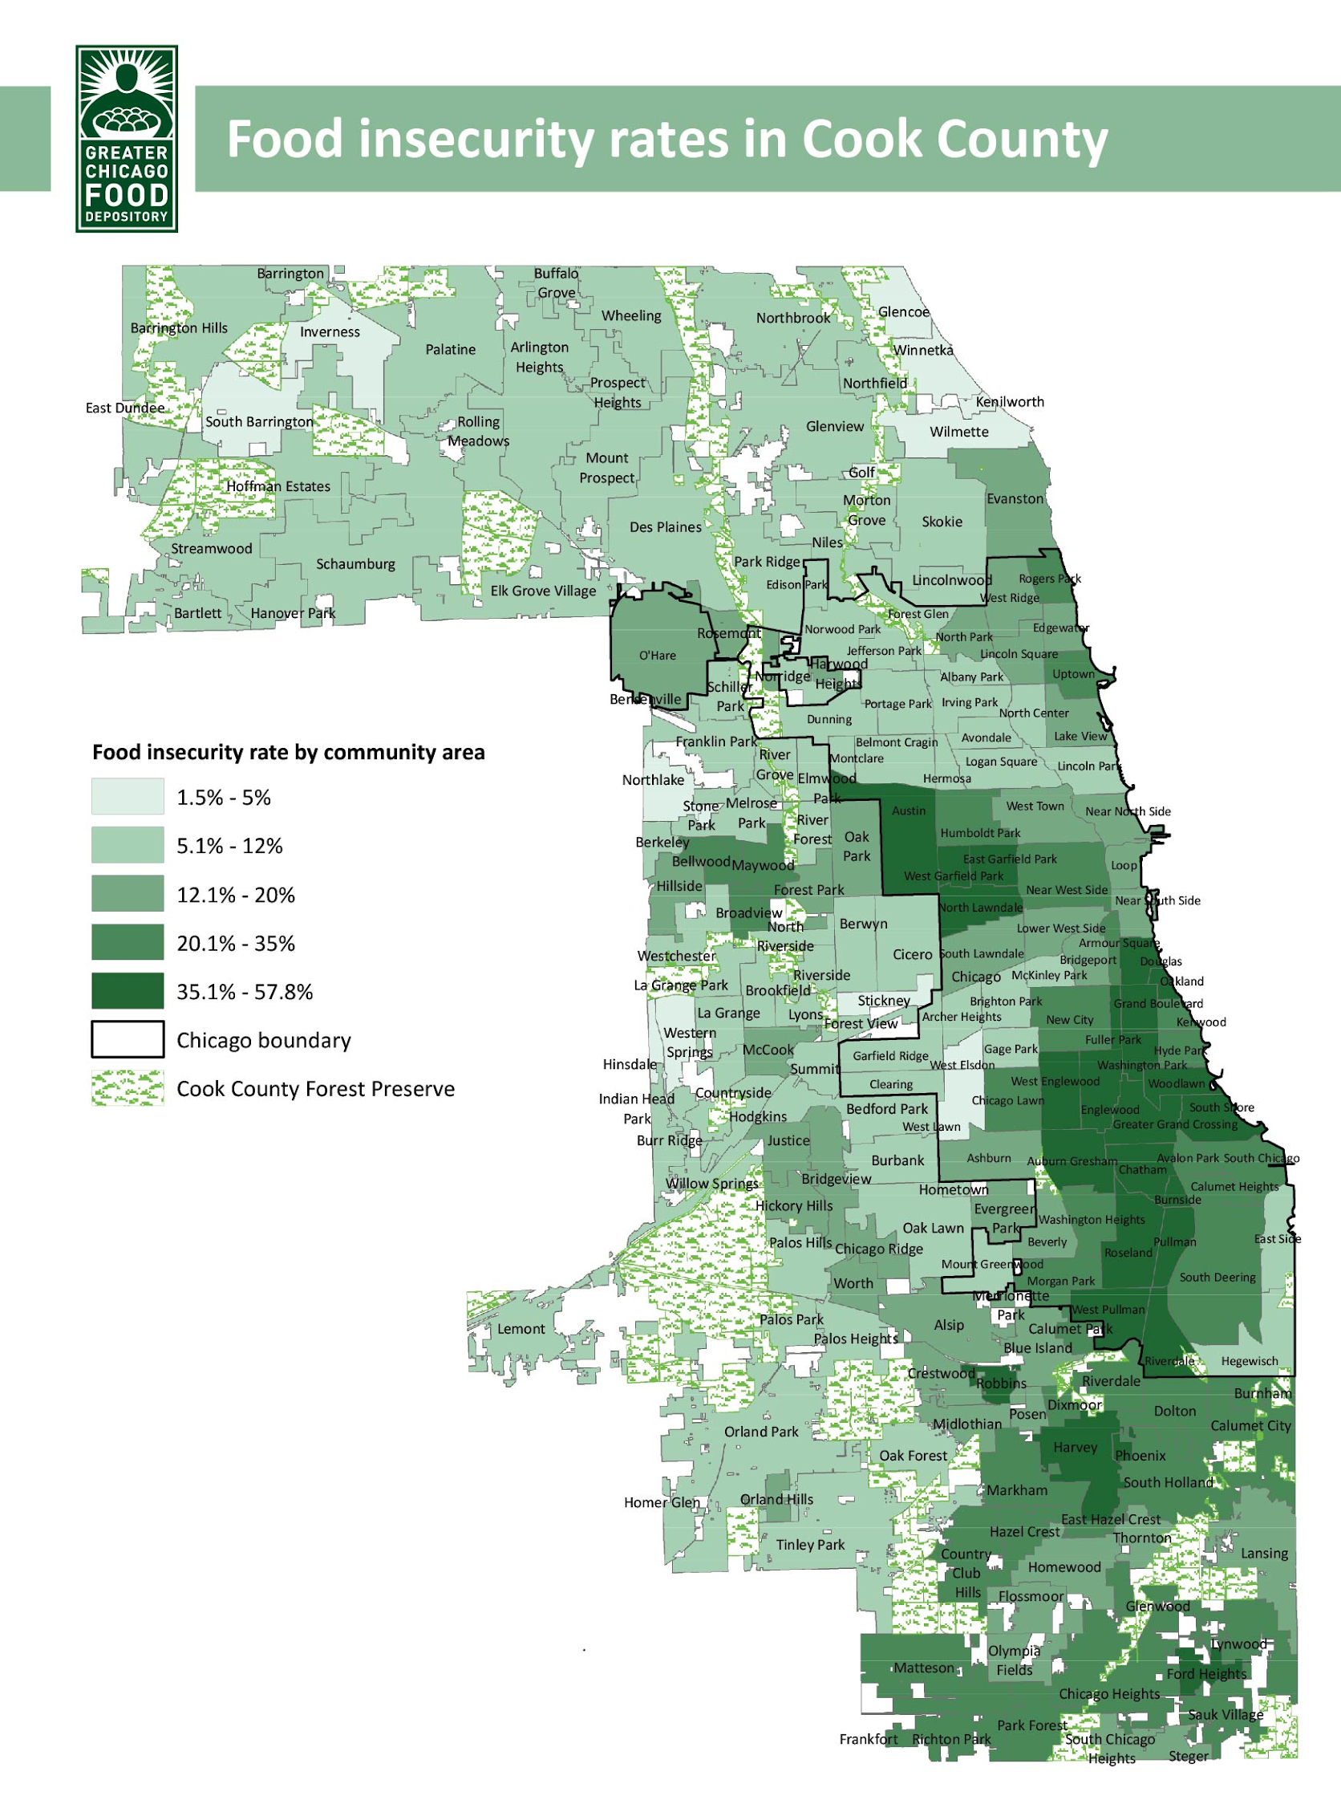
Background: Geography
Chicago is a city of neighborhoods. The hypothesis is that a localized program with community buy-in may have a better chance of finding success. Other philanthropic institutions have reached the same conclusion.
Englewood, North Lawndale, and Austin rank in the top 12 underserved neighborhoods in Chicago regarding food access, as measured by the Healthy Chicago 2.0 Hardship and Child Opportunity Index. Additionally, other neighborhoods in the top 12, such as South Lawndale and West Englewood are adjacent to these three neighborhoods (and Austin and North Lawndale are also neighbors).
Moreover, these neighborhoods have a prevalence of involved community organizations organizing around food.
Greater Chicago Food Depository

Slide 5
Background: Food Systems in Chicago (FSIC) Theory of Change
Goal: Chicago citizens in North Lawndale, Englewood, and Austin have the knowledge and access that allows them to eat in a way that supports their long-term health.
Theory of Change:
IF Builders Initiative funds efforts around food assistance programs, food access/community distribution, cultural norms and knowledge, supporting the next generation of food careers, and enabling conditions for healthy food systems in three communities in Chicago…
AND IF those efforts demonstrate the viability of buying healthy food; foster enabling conditions for a healthy and nutritious food system; and advance mental models connecting the role of food with health outcomes…
THEN we will see key improvements in the food systems of target communities, including shifts in markets toward purchasing healthy food and shifts in minds toward the prioritization of healthy food in diets…
SO THAT the people living in those communities eat in a way that supports their long-term health.

Slide 6







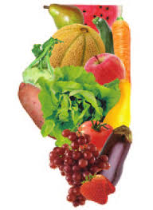
Background: FSIC Initiative Theory of Change (visual)
Strategies:
If we focus on key parts of the local healthy food system in target neighborhoods….
Interim Results:
Then we will see the following changes in the next few years…
Long-Term Results:
That will build toward longer-term shifts including:
Ultimate Impacts:
Contributing to community-level health improvements:
Healthy food is demonstrated to be economically viable in target neighborhoods, such that it is:
More affordable
More available
Locally grown
Shifts in Markets:
Community members have purchasing habits that prioritize healthy food
Decreased prevalence of:
Food Assistance
Austin
Community Distribution
The local healthy food movement is stronger in target neighborhoods, such that it is:
More skilled
More mature
More effective
Better funded
Shifts in the System:
Other neighborhoods adopt and adapt systemic approaches to improving healthy food
Food-focused community groups are more engaged
More favorable policies that promote and enable healthy eating
Obesity
Hypertension
Diabetes
Englewood
Norms & Knowledge
More community members in target neighborhoods have mental models that demonstrate:
Improved knowledge about relationship between food and health
Increased awareness about available resources
More positive attitudes about food
Shifts in Minds: More people…
Have positive attitudes
Have food aspirations
Are empowered to make well-informed nutrition choices and adopt healthy, life-long habits
Are more engaged in public dialogue about healthy food
Food Careers
North Lawndale
System Building

Slide 7
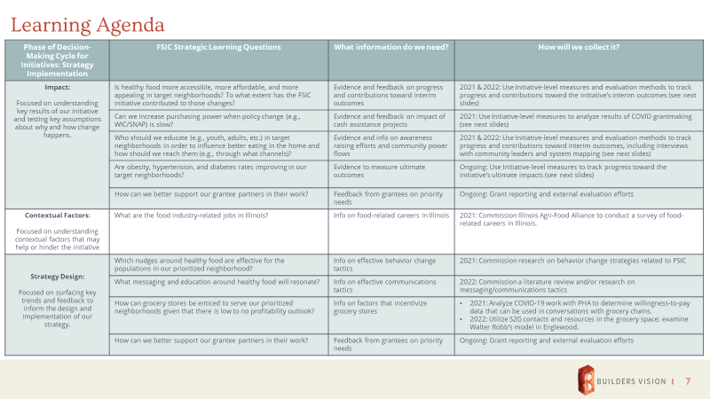
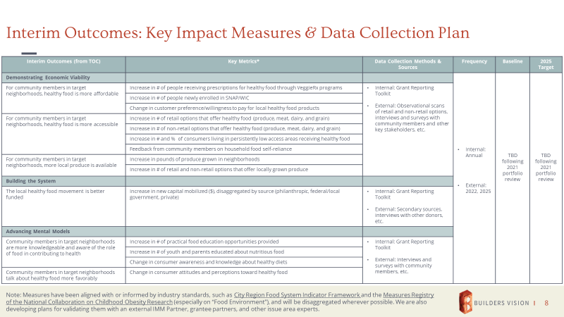
Background: FSIC IMM Framework
As a place-based, system change initiative, learning is centered around information related to FSIC’s contributions to impact, the context in which it operates, and the design and implementation of the initiative overall
In each neighborhood, impact is understood as contributions to interim outcomes as measured by key impact metrics
To date, IMM activities have been limited to the collection of grant reports as part of BI’s standard reporting process; there has not yet been a review of grant-level data against Initiative-level aims

Slide 8



About this Portfolio Review
PURPOSE
How has grantmaking been implemented to date? Where did the grant dollars go and for what purpose?
How has the work been impacted by COVID and other contextual factors?
What has been the impact of the work so far? Biggest accomplishments? Challenges?
METHODOLOGY
Conducted quantitative analysis of grants and grant dollars, segmenting by both strategy and geography
Reviewed grant documents for all 28 grants, including applications, letters, and reports (where available)
Interviewed Haven to collect additional insights
Synthesized and documented key themes and takeaways
CAVEATS
The vast majority of grantee activity took place during the COVID-19 pandemic, which affected grantee operations as well as the food ecosystem in the region
Only 11 (39%) grantees submitted a report at the time of this review
Grant agreements were articulated before an IMM framework for FSIC had been developed

Slide 9
Table of Contents
FSIC Background
Purpose of Portfolio review
Key findings
  Implementation
  Context
  Impact (By Neighborhood)
Key INSIGHTS
Appendix

Slide 10
Implementation: FSIC Initiative over Time
First grant made to N. Lawndale, making it the strategy’s third neighborhood
Significant funding to open community corner store in Englewood
Initial grants made to Austin, establishing it as the second neighborhood
Significant additional dollars went to COVID emergency relief in 2020 and 2021
Haven joins as Program Officer
Englewood receives funding as strategy’s first neighborhood
$3.0M grant to Chicago Food System Region Fund

Slide 11
Implementation: FSIC at a Glance
By year
$10.5M
in total funding committed via
28
grants with
²
By neighborhood
By strategy
Most grants are around one year in length
1.1
years in average length¹ and
Only one funded project so far in N. Lawndale
$200K
median size going to
22
grantees
More than half of funding has gone to city-wide projects
Food Careers and Cultural Norms make up just over 10% of total funding
¹ Start and end dates only available for 23 out of 28 grants.
² The Grant to Austin Fresh, which cuts across all strategies, has been coded as “system-building”.

Slide 12
Implementation: FSIC over Time
System building is the bulk of the funding in 2021, largely due to a $3M grant to the Chicago Region Food System Fund
City Wide funding increased significantly from 2018 to 2021
Community distribution was a significant focus in 2019 and 2020, but less so in 2021 (so far)
Note: The Grant to Austin Fresh, which cuts across all strategies, has been coded as “system-building”.

Slide 13
Implementation: Portfolio by Grantee
Primary strategy
Secondary strategy
# | Grantee | Food Assistance | Community Distribution | Cultural Norms | Food Careers | System Building | Funding | % of Total
1 | Chicago Region Food System Fund |  |  |  |  |  | $3,000,000 | 28.5%
2 | Inner-City Muslim Action Network |  |  |  |  |  | $1,850,000 | 17.6%
3 | Greater Chicago Food Depository |  |  |  |  |  | $956,533 | 9.1%
4 | Gary Comer Youth Center |  |  |  |  |  | $750,000 | 7.1%
5 | Westside Health Authority |  |  |  |  |  | $637,695 | 6.1%
6 | Austin Fresh |  |  |  |  |  | $500,000 | 4.8%
7 | FamilyFarmed |  |  |  |  |  | $450,000 | 4.3%
8 | PCC Community Wellness Center |  |  |  |  |  | $445,000 | 4.2%
9 | Lawndale Christian Health Center |  |  |  |  |  | $400,000 | 3.8%
10 | Growing Home, Inc. |  |  |  |  |  | $305,000 | 2.9%
11 | Grow Greater Englewood |  |  |  |  |  | $275,700 | 2.6%
12 | Experimental Station |  |  |  |  |  | $250,000 | 2.4%
13 | Common Market Philadelphia Inc |  |  |  |  |  | $151,515 | 1.4%
14 | NeighborSpace |  |  |  |  |  | $99,900 | 1.0%
15 | Austin Coming Together |  |  |  |  |  | $83,250 | 0.8%
16 | Advocates for Urban Agriculture |  |  |  |  |  | $72,260 | 0.7%
17 | Fresh Taste |  |  |  |  |  | $60,000 | 0.6%
18 | Faith in Place |  |  |  |  |  | $56,610 | 0.5%
19 | BUILD Incorporated |  |  |  |  |  | $53,946 | 0.5%
20 | Global Philanthropy Partnership |  |  |  |  |  | $50,000 | 0.5%
21 | By the Hand Club for Kids |  |  |  |  |  | $49,950 | 0.5%
22 | GAP community Center |  |  |  |  |  | $14,860 | 0.1%
68%
of total funding went to these
5 grantees
20%
of total funding went to these
5 grantees
12%
of total funding went to these 12 grantees

Slide 14
Table of Contents
FSIC Background
Purpose of Portfolio review
Key findings
  Implementation
  Context
  Impact (By Neighborhood)
Key INSIGHTS
Appendix

Slide 15
Context: The external context has a significant impact on FSIC’s implementation and strategy.
There are numerous other funding and programmatic organizations that are already working in Chicago food systems (see slide 16).
COVID-19 severely disrupted nonprofit operations in the city. The pandemic has increased the focus on rapid response services and resulted in delays to planned projects (see slides 17-18).
The demonstrations following the murder of George Floyd created unrest in targeted neighborhoods, further increasing the need for food access.
Greater Chicago Food Depository

Slide 16
Context: FSIC is one of many initiatives working with food in Chicago
Ecosystem Map¹
Key Actor | Cultural Norms | System Building | Food Assistance | Food Careers
Christopher Family Foundation
Lumpkin Family Foundation
Food:Land:Opportunity
Other Local Foundations / Philanthropy
Kresge
Other National Foundations / Philanthropy
Local Universities / Think Tanks / Alliances / Associations
National Exemplars
Growing Home |  | Englewood
Grow Greater Englewood |  | Englewood
Farm on Ogden |  | North Lawndale
Windy City Harvest
Other NGOs / Implementers in our Neighborhoods |  | Englewood / Austin
There are numerous other philanthropic organizations (both small and large) funding programming around FSIC’s key strategies.
Chicago is home to various coalitions and thought leaders advancing food efforts.
There are strong community organizations working in targeted neighborhoods to provide food services to residents.
1 Simplified table taken from “Food Systems in Chicago Strategy” deck, updated August 2021.

Slide 17
Context: COVID disproportionately impacted Black and Brown Chicagoans¹
Black Chicagoans were more than twice as likely as White residents to die from COVID. Latinx Chicagoans were about 70% more likely.
Black residents also did not experience the same jobs recovery as other ethnic groups. While the White employment rate increased by 4.6 percentage points between June 2020 and June 2021, the Black employment rate fell by 5.4 points.
This has led to higher rates of food insecurity. Feeding America estimates that Cook County food insecurity increased from 10% in 2018 to 15% in 2020 and this is borne disproportionately by Black and Latinx households.
Chicago Data Portal
Illinois Policy
1 Information summarized from “COVID-19 Initiative Interim Report,” October 2021

Slide 18
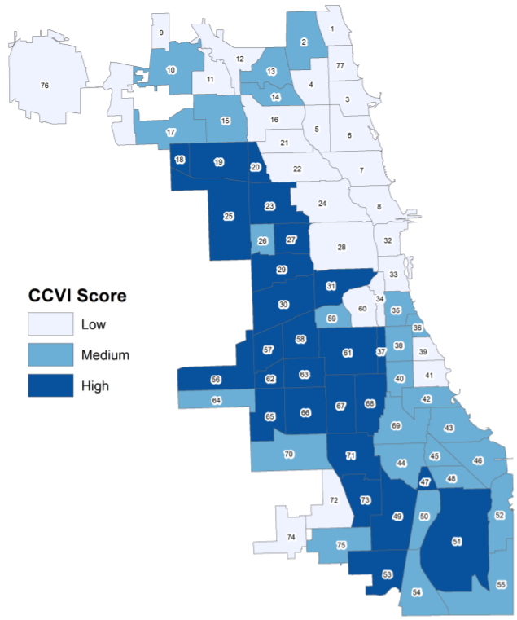



Context: COVID impacted how community organizations engage in their work
Chicago COVID-19 Vulnerability Index (CCVI)
Examples of the impact of COVID on funded organizations:
Virtual programming: The Gary Comer Youth Center immediately moved one of its flagship youth programs, Comer Crops, to a virtual setting and was forced to make rapid adjustments to curriculum and engagement practices.
Programmatic delays: The Fresh Market, a new community-driven corner grocery store, was forced to delay its opening as a result of the pandemic and related funding challenges.
Shifts in clients served: Lawndale Christian Health Center shifted to serving fewer clients with its VeggieRx program but providing deeper services over a longer period.
Chicago Department of Public Health

Slide 19
Table of Contents
FSIC Background
Purpose of Portfolio review
Key findings
  Implementation
  Context
  Impact (By Neighborhood)
Key INSIGHTS
Appendix

Slide 20
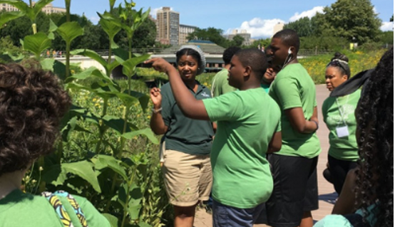
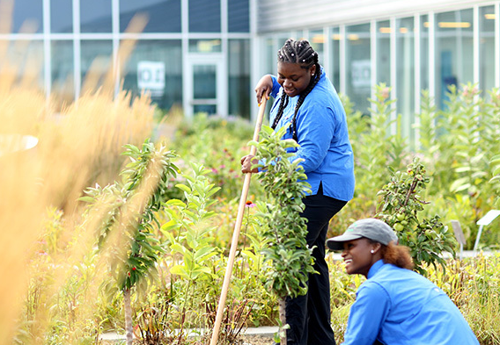
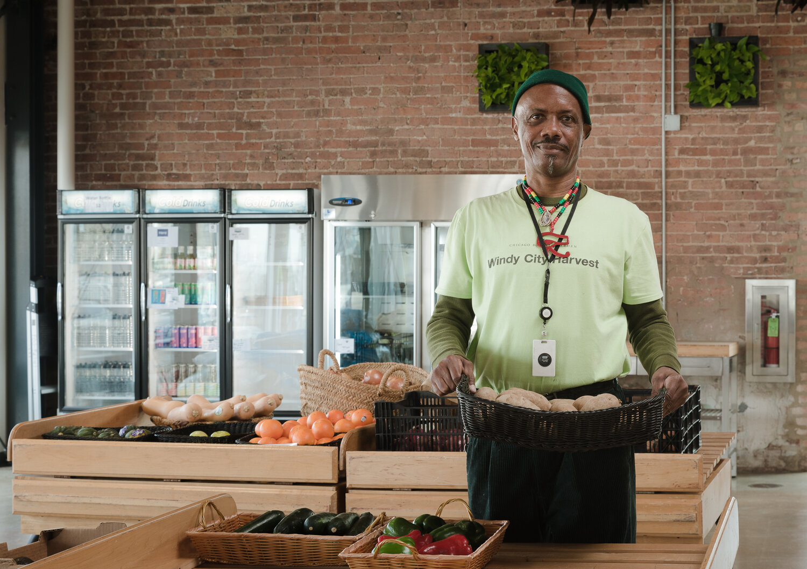
Impact Highlights¹
UPDATED
Demonstrating Economic Viability
residents in targeted neighborhoods are now receiving regular access to healthy food through VeggieRx and other food programs
plans are in place to develop new community-driven grocery stores through Inner-City Muslim Action Network and the Westside Health Authority
Pounds of produce grown through targeted funding
Advancing Mental Models
Youth and adults attended education programs to build their awareness and skills around nutrition and urban farming
851
792
2
26,931
Building the System
Youth and underemployed adults were trained for careers in the food workforce
Custodial caps removed from fire hydrants to provide water for urban farms
Additional dollars raised for food systems funding
204
3
3.8 M
1 All impact results are likely to be an undercount. Most grants are still underway and we have only received reports from 39% of funded projects.

Slide 21
Impact Spotlight: Englewood
Builders began work in Englewood in late 2019, making it the first targeted neighborhood of the strategy.
The biggest investment to date has been in the Fresh Market, a community driven grocery score scheduled to open in early 2022.
Englewood has a particularly strong emphasis on urban farming and agriculture programs. A focus of the strategy has been keeping that produced food in the neighborhood.
$2.6M
in total funding committed via
6
grants
Grantee | Purpose | Strategy | Funding
Common Market Philadelphia Inc | Planning for replication of Common Market Philly | System Building | $ 151,515
Growing Home, Inc. | Increase healthy food distributing in Englewood | Community Dist | $ 305,000
Inner-City Muslim Action Network | to support Phase I and Phase II of the Fresh Market | Community Dist | $ 500,000
Grow Greater Englewood | to support Englewood Village Farms. | Community Dist | $ 275,700
Inner-City Muslim Action Network | to support the Fresh Market is a food coop | Community Dist | $ 1,000,000
Inner-City Muslim Action Network | to support Phase I and Phase II of the Fresh Market | Community Dist | $ 350,000

Slide 22
Impact Spotlight: Englewood
Key Accomplishments
Growing Home increased the percentage of grown produce staying in Englewood from 20 to 50%
Fresh Market, a new corner store with healthy food, is scheduled to open in early 2022
Grow Greater Englewood is building infrastructure to better support urban farms
Priority impact metric | Grantee data (as of 10/21)¹
Demonstrating Economic Viability
# of retail or non-retail options that offer healthy food | One new option will be provided through Fresh Market (IMAN)
Increase in pounds of produce grown in neighborhoods | 2,000 pounds of produce (Growing Home)
# of consumers living in persistently low access areas receiving healthy food | 129 residents with access to healthy food (IMAN & Growing Home)
Change in customer awareness and willingness to pay for local healthy food products (qualitative) | None reported²
Advancing Mental Models
# of youth and adults attending events designed to raise awareness of healthy food, farming, and cooking | Total not available, but some events were held (Growing Home & Grow Greater)
Change in consumer awareness and knowledge about healthy diets (qualitative) | None reported²
Building the System
# of youth and underemployed adults trained for the food workforce | 60 people trained through Green ReEntry (IMAN)
# of new donors and $ capitalized on issues related to healthy food | None reported
¹ Of the six grants in this neighborhood, three have provided a report by end of October 2021.
² Data for these metrics will be collected via other data collection methods, e.g., interviews, observational scans, research, etc.

Slide 23
Impact Spotlight: Austin
Builders began work in Austin in mid-2020 making it the second targeted neighborhood of the strategy.
Builders entered the work as part of a funder’s collaborative, committing $500K to the neighborhood and leveraging an additional $500K.
Austin has a strong collaborative backbone, working together to address issues in the community. Builders funds a committee (Austin Eats) focused on food and nutrition issues.
$1.9M
in total funding committed via
10
grants
Grantee | Purpose | Strategy | Funding
PCC Community Wellness Center | Pilot of Veggie Rx program at PCC | Food Assistance | $ 145,000
Faith in Place | Kitchen partnership with Greater St John Bible Church | Cult Norms | $ 56,610
GAP community Center | Chiquitos in the Kitchen | Cult Norms | $ 14,860
NeighborSpace | NBSP’s Austin community gardens | Cult Norms | $ 99,900
By the Hand Club for Kids | Austin Harvest youth program | Food Careers | $ 49,950
BUILD Incorporated | Iris garden and Austin Grown youth program | Cult Norms | $ 53,946
Westside Health Authority | Development of Forty Acres grocery | Comm dist | $ 637,695
Austin Coming Together | Austin Coming Together as a convener of food players | System building | $ 83,250
PCC Community Wellness Center | Continuation of the Veggie Rx Program in Austin | Food assistance | $ 300,000
Austin Fresh | Year 2 of Austin Fresh | System Building | $ 500,000

Slide 24
Impact Spotlight: Austin
Key Accomplishments
As part of funder’s collaborative, leveraged $500K of additional funding
Plans in place to open new, community-driven grocery store
105 residents have regular access to healthy food through VeggieRx
Chiquitos in the Kitchen plans to provide 60 students/year with cooking and gardening education
Priority impact metric | Grantee data (as of 10/21)¹
Demonstrating Economic Viability
# of retail or non-retail options that offer healthy food | The Westside Health Authority is developing plans to develop a community grocery store
Increase in pounds of produce grown in neighborhoods | None reported
# of consumers living in persistently low access areas receiving healthy food | 105 residents receiving healthy food through VeggieRx (PCC)
Change in customer awareness and willingness to pay for local healthy food products (qualitative) | None reported²
Advancing Mental Models
# of youth and adults attending events designed to raise awareness of healthy food, farming, and cooking | Plans to serve 230 youth and adults per year (GAP, Faith in Place, NeighborSpace, BUILD Inc.)
Change in consumer awareness and knowledge about healthy diets (qualitative) | None reported²
Building the System
# of youth and underemployed adults trained for the food workforce | Plan to train 45 students (By the Hand Club for Kids and BUILD Inc.)
# of new donors and $ capitalized on issues related to healthy food | Austin Coming Together has a target to raise $313K. Additionally, $500K was raised as part of funders collaborative.
¹ Of the 10 grants in this neighborhood, 1 has provided a report by end of October 2021.
² Data for these metrics will be collected via other data collection methods, e.g., interviews, observational scans, research, etc.

Slide 25
Impact Spotlight: North Lawndale
$0.4M
in total funding committed via
Builders began work in North Lawndale in mid-2020, making it the third targeted neighborhood of the strategy.
The only grant thus far has been to the Lawndale Christian Health Center to expand the VeggieRx program beyond those who currently hold SNAP benefits.
Leveraged two additional funders to join the work in North Lawndale and are currently planning for an RFP process in 2022 focused on food access, gardening, and food education.
1
grant
Grantee | Purpose | Strategy | Funding
Lawndale Christian Health Center | Farm on Ogden’s VeggieRx expansion | Food Assistance | $400,000

Slide 26
Impact Spotlight: North Lawndale
Key Accomplishments
Brought in two additional funders to the neighborhood, increasing the amount of dollars available
617 residents received regular healthy food access through the VeggieRx program
The percentage of VeggieRx participants who reported eating more than one cup of vegetables a day increased by 16%
Priority impact metric | Grantee data (as of 10/21)
Demonstrating Economic Viability
# of retail or non-retail options that offer healthy food | None reported
Increase in pounds of produce grown in neighborhoods | None reported¹
# of consumers living in persistently low access areas receiving healthy food | 617 patients received regular healthy food through VeggieRx
Change in customer awareness and willingness to pay for local healthy food products (qualitative) | None reported¹
Advancing Mental Models
# of youth and adults attending events designed to raise awareness of healthy food, farming, and cooking | None reported
Change in consumer awareness and knowledge about healthy diets (qualitative) | The % of participants that reported eating more than one cup of vegetables per day increased by 16%¹
Building the System
# of youth and underemployed adults trained for the food workforce | None reported
# of new donors and $ capitalized on issues related to healthy food | None reported
¹ Data for these metrics will be collected via other data collection methods, e.g., interviews, observational scans, research, etc.

Slide 27
Impact Spotlight: Citywide Chicago
Builders made its first Citywide Chicago grant in late 2018.
The most significant investment was in the Chicago Region Food System Fund, which brought funders together to serve as a central resource point for food-related COVID-relief.
Several grantees are also focused on policy influence and change, from the LinkUp program to enrolling residents in SNAP and WIC to advocating for increased access to water for urban farms.
$5.6M
in total funding committed via
11
grants
Grantee | Purpose | Strategy | Funding
Experimental Station | LINK Up Illinois and food education/farmers’ market | Community Dist | $ 100,000
Gary Comer Youth Center | Green Teens and Comer Crops Crew programming | Cult Norms | $ 250,000
Experimental Station | Link Up Illinois | Food Assistance | $ 75,000
Global Philanthropy Partnership | Illinois Agri-Food Alliance’s internal capacity building | Food Careers | $ 50,000
Gary Comer Youth Center | Producing Pathways in Greater Grand Crossing | Food Careers | $ 500,000
Greater Chicago Food Depository | Creation of the Benefits Outreach Center of Expertise | Food Assistance | $ 956,533
Experimental Station | Link Up Illinois | Food Assistance | $ 75,000
Advocates for Urban Agriculture | Advocate for water rights for urban farms | System building | $ 72,260
FamilyFarmed | Good Food is Good Medicine program | System Building | $ 450,000
Chicago Region Food System Fund | Chicago Region Food System Fund | System Building | $ 3,000,000
Fresh Taste | Fresh Taste | System Building | $ 60,000

Slide 28
Impact Spotlight: Citywide Chicago
Key Accomplishments
99 students participated in Comer Crops or Green Teens, increasing their capacity around farming and nutrition
Additional funding leveraged through co-funders of the Chicago Region Food System Fund
Three fire hydrant caps were removed for urban farms
Priority impact metric | Grantee data (as of 10/21)¹
Demonstrating Economic Viability
# of retail or non-retail options that offer healthy food | None reported
Increase in pounds of produce grown in neighborhoods | 24,931 pounds of produce (Gary Comer)
# of consumers living in persistently low access areas receiving healthy food | Making LinkMatch more accessible for Chicago residents
Change in customer awareness and willingness to pay for local healthy food products (qualitative) | None reported²
Advancing Mental Models
# of youth and adults attending events designed to raise awareness of healthy food, farming, and cooking | 562 residents received food education (Experimental Station and Gary Comer)
Change in consumer awareness and knowledge about healthy diets (qualitative) | None reported²
Building the System
# of youth and underemployed adults trained for the food workforce | 99 youth trained in food and farming (Gary Comer)
# of new donors and $ capitalized on issues related to healthy food | $3.3M leveraged through Chicago Region Food System Fund. Also, Experimental Station received an $87K pledge for LinkMatch.
¹ Of the 11 grants in this neighborhood, 6 have provided a report by end of October 2021.
² Data for metrics shaded in grey will be collected via other data collection methods, e.g., interviews, observational scans, research, etc.

Slide 29
Impact Spotlight: Results across interim priority metrics
Priority impact metric | TOTAL | Englewood | Austin | N. Lawndale | City-wide
Demonstrating Economic Viability
# of retail or non-retail options that offer healthy food | 2 retail options in progress | One new option will be provided through Fresh Market (IMAN) | The Westside Health Authority is developing plans to develop a community grocery store | None reported | None reported
Increase in pounds of produce grown in neighborhoods | 26,931 pounds | 2,000 pounds | None reported | None reported | 24,931 pounds
# of consumers living in persistently low access areas receiving healthy food | At least 851 residents receiving regular food access | 129 residents with access to healthy food (IMAN & Growing Home) | 105 residents receiving healthy food through VeggieRx (PCC) | 617 patients received regular healthy food through VeggieRx | Making LinkMatch more accessible for Chicago residents
Change in customer awareness and willingness to pay for local healthy food products (qualitative) | Limited data available | None reported | None reported | None reported | None reported
Advancing Mental Models
# of youth and adults attending events designed to raise awareness of healthy food, farming, and cooking | At least 792 residents building nutrition awareness | Total not available, but some events were held (Growing Home & Grow Greater) | Plans to serve 230 youth and adults per year (GAP, Faith in Place, NeighborSpace, BUILD Inc.) | None reported | 562 residents received food education (Experimental Station and Gary Comer)
Change in consumer awareness and knowledge about healthy diets (qualitative) | Limited data available | None reported² | None reported² | The % of participants that reported eating more than one cup of vegetables per day increased by 16%¹ | None reported²
Building the System
# of youth and underemployed adults trained for the food workforce | At least 204 residents trained | 60 people trained through Green ReEntry (ICMAN) | Plan to train 45 students (By the Hand Club for Kids and BUILD Inc.) | None reported | 99 youth trained in food and farming (Gary Comer)
# of new donors and $ capitalized on issues related to healthy food | At least $3.8M raised through funded projects | None reported | Austin Coming Together has a target to raise $313K. Additionally, $500K was raised as part of funders collaborative. | None reported | $3.3M leveraged through Chicago Region Food System Fund & Experimental Station received an $87K pledge for LinkMatch.

Slide 30
Table of Contents
FSIC Background
Purpose of Portfolio review
Key findings
  Implementation
  Context
  Impact (By Neighborhood)
Key INSIGHTS
Appendix

Slide 31
So What?: Insights
UPDATED
Design & Implementation
Impact
There is a delicate balance between being a large funder and ensuring you don’t co-opt the community’s goals and priorities.
The strategy can only be effective with strong relationships at various levels: hyper-local within neighborhoods, citywide, and at the state.
With more established grantees, there are opportunities for more multi-year grants for general operating support.
There may be opportunities for Builders to play a role in convening organizations across neighborhoods for shared learning and network building.
The potential of building new, brick and mortar grocery stores has created a lot of buzz in two of the neighborhoods.
Demonstrating economic viability in neighborhoods has to be a long-term goal. It will take time and the implications of the funding may not be seen for several years.
Context
A key to community-driven change is fostering and strengthening the conditions that enable communities to engage directly in the work.
COVID brought funding to the work of many small community-based organizations, but they will need continued funding to thrive.
The pandemic brought several funders together with increased urgency and aligned interest around food systems.
The City of Chicago creates challenges for the strategy with its bureaucracy and reluctance to change policies.
New funding came to Chicago through federal and state funds during the pandemic, but there is always a risk that promised dollars do not come through.
“Advancing mental models” was made challenging during the pandemic and will require different evaluation methods to assess.
Note: Following the completion of the first part of this report, we convened a diverse group of internal staff to engage in a “sensemaking” conversation. You can see notes from the session here and a summary in the slides that follow.

Slide 32
Now What?: What does this mean for the work?
UPDATED
Design & Implementation
Impact
Key Action:
Develop methods to better engage intermediary organizations. Implement processes that help us understand who is impacted through intermediaries and in what ways.
Questions for consideration:
What are the criteria for which we would consider offering longer-term, general operating support grants?
How can we better track and understand our non-grant work (e.g. relationship building)? Are there systems we could implement?
How can we collect more feedback from grantee partners on your strategy and community needs?
Key Action:
Focus more resources on the “demand-side” of food systems work. Fund programs that work to build awareness and knowledge around nutrition and food.
Questions for consideration:
What are the options for moving our evaluation work forward to include mixed-methods and participatory data collection?
How might we better define our impact goals with the city-wide funding?
How can we work with grantees to collect stronger qualitative data, especially with our “advancing mental models” funding.
Context
Key Action:
TBD
Questions for consideration:
Are there opportunities to use strategic communications to drive awareness and action around food systems?
What would an increased focus on improving the Chicago policy landscape look like?
With a decreased focus on COVID, how do we need to adjust the Chicago city-wide funding?

Slide 33
Questions for consideration: 3I Expansion
UPDATED
Design & Implementation
Impact
How do we best build relationships and trust across three different states?
Will the 3I strategy be neighborhood / community based as well? How will those sites be selected?
Is it feasible or scalable to continue to seed community grocery stores across a larger footprint?
Given the scale, we will need to turn down more grantees. How can we do that while keeping organizations engaged?
What does it look like to “scale slowly” to ensure we don’t burn bridges or exceed our capacity?
What are the baseline values for emerging outcome metrics for this Initiative?
How will our work need to be different in rural areas vs. in Chicago?
How will our balance of “supply-side” work and “demand-side” work shift in the 3I states?
Context
What are the opportunities to work with local intermediaries who can regrant dollars more effectively?
Are there opportunities to scale successful programs in Chicago to 3I (e.g. VeggieRx)?
Note: In addition to reflecting on the FSIC strategy, we also had a conversation about the implications of this work on the broader expansion to the “3I” states. Below are the key questions that developed out of that conversation.

Slide 34
Table of Contents
FSIC Background
Purpose of Portfolio review
Key findings
  Implementation
  Context
  Impact (By Neighborhood)
Key INSIGHTS
Appendix

Slide 35
FSIC Interim Outcomes Measurement Framework
Dark shading: primary data collection method
Light shading: secondary data collection method
Interim outcomes
Key Interim Outcome Metrics | Grant reports/ interviews | Community survey | Community focus groups | Policy monitoring | Observational scan
# of people newly enrolled in SNAP/WIC
# of retail options that offer healthy food
# of non-retail options that offer healthy food
Pounds of produce grown in neighborhoods
# of total community members served by food access vendors
# of community members receiving regular access to healthy food
# of youth and underemployed adults trained for the food workforce
# of youth and underemployed adults placed in the food workforce
# of food entrepreneurs supported
# of food enterprises launched
# of CBOs that are part of community coalitions related to the healthy food movement
Level of collaboration with other movements (qualitative)
New evidence and knowledge about behavior change and shifting norms
Policies developed/proposed/enacted related to urban farming and healthy food
# of new donors and $ capitalized on issues related to healthy food
# of youth and adults attending events designed to raise awareness of healthy food, farming, and cooking
# of youth and adults participating in intensive skill-building in healthy food, farming, and cooking
Change in consumer awareness and knowledge about healthy diets (qualitative)
% of community members who desire to purchase healthy food
Food Assistance
Healthy food is demonstrated to be economically viable in target neighborhoods:
More affordable
More available
Locally grown
Community Distribution
Food Careers
The local healthy food movement is stronger in target neighborhoods:
More skilled
More mature
More effective
Better funded
System Building
More community members have mental models that demonstrate:
Improved knowledge about food and health
Increased awareness about resources
More positive attitudes about food
Norms & Knowledge

Slide 36
FSIC Learning Agenda
Information Category | FSIC Strategic Learning Questions | What information do we need? | How will we collect it?
Impact: Focused on understanding key results of our initiative and testing key assumptions about why and how change happens. | Is healthy food more accessible, more affordable, and more appealing in target neighborhoods? To what extent has the FSIC initiative contributed to those changes? | Evidence and feedback on progress and contributions toward interim outcomes | 2021 & 2022: Use Initiative-level measures and evaluation methods to track progress and contributions toward the initiative’s interim outcomes (see next slides)
Strategy Implementation / Development | Can we increase purchasing power when policy change (e.g., WIC/SNAP) is slow? | Evidence and feedback on impact of cash assistance projects | 2021: Use Initiative-level measures to analyze results of COVID grantmaking (see next slides)
 | Who should we educate (e.g., youth, adults, etc.) in target neighborhoods in order to influence better eating in the home and how should we reach them (e.g., through what channels)? | Evidence and info on awareness raising efforts and community power flows | 2021 & 2022: Use Initiative-level measures and evaluation methods to track progress and contributions toward interim outcomes, including interviews with community leaders and system mapping (see next slides)
 | Are obesity, hypertension, and diabetes rates improving in our target neighborhoods? | Evidence to measure ultimate outcomes | Ongoing: Use Initiative-level measures to track progress toward the initiative’s ultimate impacts (see next slides)
Contextual Factors: Focused on understanding contextual factors that may help or hinder the initiative | What are the food industry-related jobs in Illinois? | Info on food-related careers in Illinois | 2021: Commission Illinois Agri-Food Alliance to conduct a survey of food-related careers in Illinois.
Strategy Design: Focused on surfacing key trends and feedback to inform the design and implementation of our strategy. | Which nudges around healthy food are effective for the populations in our prioritized neighborhood? | Info on effective behavior change tactics | 2021: Commission research on behavior change strategies related to FSIC
 | What messaging and education around healthy food will resonate? | Info on effective communications tactics | 2022: Commission a literature review and/or research on messaging/communications tactics
 | How can grocery stores be enticed to serve our prioritized neighborhoods given that there is low to no profitability outlook? | Info on factors that incentivize grocery stores | 2021: Analyze COVID-19 work with PHA to determine willingness-to-pay data that can be used in conversations with grocery chains. 2022: Utilize S2G contacts and resources in the grocery space; examine Walter Robb’s model in Englewood.
 | How can we better support our grantee partners in their work? | Feedback from grantees on priority needs | Ongoing: Grant reporting and external evaluation efforts

Slide 37
Spotlight: Food Assistance
$2.0M
in total funding committed via
Description
Increase the reach of food assistance programs in our three target neighborhoods
Key Partner Activities | 1. Increasing enrollment of the public in, raising awareness about, and/or advocating for SNAP/WIC 2. Proliferating Food as Medicine and Veggie Rx programs
6
grants²
Priority Impact Metrics¹ | Grantee Data (as of 10/2021)²
# of consumers living in persistently low access areas receiving healthy food³ | At least 851 residents receiving regular food access
Change in customer preference/willingness to pay for local healthy food products | None reported
1 Data for metrics shaded in grey will be collected via other data collection methods, e.g., interviews, observational scans, research, etc.
2 Of the 6 grants in this strategy, 3 have provided a report by end of September 2021.
3 This metric overlaps with the Community Distribution strategy area.

Slide 38
Spotlight: Community Distribution
$3.2M
in total funding committed via
Description
Increase access to fresh food in our three target neighborhoods.
Key Partner Activities | Building, scaling, or networking innovative models that promote community ownership to distribute and/or make healthy food more affordable and accessible in retail and non-retail settings.
7
grants
Priority Impact Metrics¹ | Grantee Data (as of 10/2021)²
# of retail or non-retail options that offer healthy food | 2 additional retail options in progress
# of consumers living in persistently low access areas receiving healthy food³ | At least 851 residents receiving regular food access
Increase in pounds of produce grown in neighborhoods | 26,931 pounds
1 Data for metrics shaded in grey will be collected via other data collection methods, e.g., interviews, observational scans, research, etc.
2 Of the 7 grants in this strategy, 3 have provided a report by end of September 2021.
3 This metric overlaps with the Food Assistance strategy area.

Slide 39
Spotlight: Cultural Norms and Knowledge
$0.5M
in total funding committed via
Description
Elevate the cultural norms that drive healthy behavior among youth and parents.
Key Partner Activities | Educating community members about healthy eating and nutrition and managing community kitchen and/or community cooking class models.
5
grants
Priority Impact Metrics | Grantee Data (as of 10/2021)²
# of youth and adults attending events designed to raise awareness of healthy food, farming, and cooking | At least 792 residents building nutrition awareness
Change in consumer awareness and knowledge about healthy diets | None reported
¹ Data for metrics shaded in grey will be collected via other data collection methods, e.g., interviews, observational scans, research, etc.
² Of the 5 grants in this strategy, only one has provided a report by end of September 2021.
³ In addition, Growing Home reports 3,200 participants through online engagement and community events.

Slide 40
Spotlight: Food Careers
$0.6M
in total funding committed via
Description
Increase opportunities for Chicago youth and underemployed adults to enter the workforce in food-related industries.
Key Partner Activities | Job training and mentoring programs for youth that expose them to food-related careers Job training programs for underemployed adults that provide apprenticeships Job placement in food-related careers and launching food-related enterprises.
3
grants
Priority Impact Metrics¹ | Grantee Data (as of 10/2021)²
# of youth and underemployed adults trained for the food workforce | At least 204 residents trained
¹ Data for metrics shaded in grey will be collected via other data collection methods, e.g., interviews, observational scans, research, etc.
² Of the 3 grants in this strategy, only one has provided a report by end of September 2021.

Slide 41
Spotlight: System Building
$4.3M
in total funding [committed] via
Description
Aiming to build the knowledge, capacity, leadership and connectivity of actors in and adjacent to the healthy food movement to foster the enabling conditions for shifting markets and minds toward healthy food.
Key Partner Activities | Advocating with current and potential new funders, including federal and state funding streams, policy and advocacy.
7
grants
Priority Impact Metrics¹ | Grantee Data (as of 10/2021)²
# of new donors and $ capitalized on issues related to healthy food | At least $3.8M raised through funded projects
¹ Data for metrics shaded in grey will be collected via other data collection methods, e.g., interviews, observational scans, research, etc.
² Of the 7 grants in this strategy, only one has provided a report by end of September 2021.

Slide 42
Spotlight: COVID Funding¹
Goal
All 16 neighborhoods survive the crisis with appropriate food and provisions
$12.1M
in total funding committed via
Primary Metric
52
Pounds of food and/or number of food boxes provided
grants
Focus grantmaking dollars on neighborhood anchor institutions as they are closest to the work and are best positioned to understand community need
In neighborhood-specific grants
Strategy
$4.5M
In grants that spanned neighborhoods
$7.5M
Food delivery: 500,000 meals, 21,000 food boxes, and almost 7M pounds of food
New food system providers: At least 12 community nonprofits newly entered the neighborhood food system
New funders: BI now has 4 funding partners in food systems
Elevating voices: After connecting with grassroot organizations, the Greater Chicago Food Depository now plans to open culturally competent food pantries in targeted neighborhoods
Grant range
$10K-3M
Impact²
Median grant size
$66K
1 Information summarized from “COVID-19 Initiative Interim Report,” October 2021
2 These are an undercount of the ultimate results: the grants for 33% of the funds had not yet provided final reports.

