Slide 1
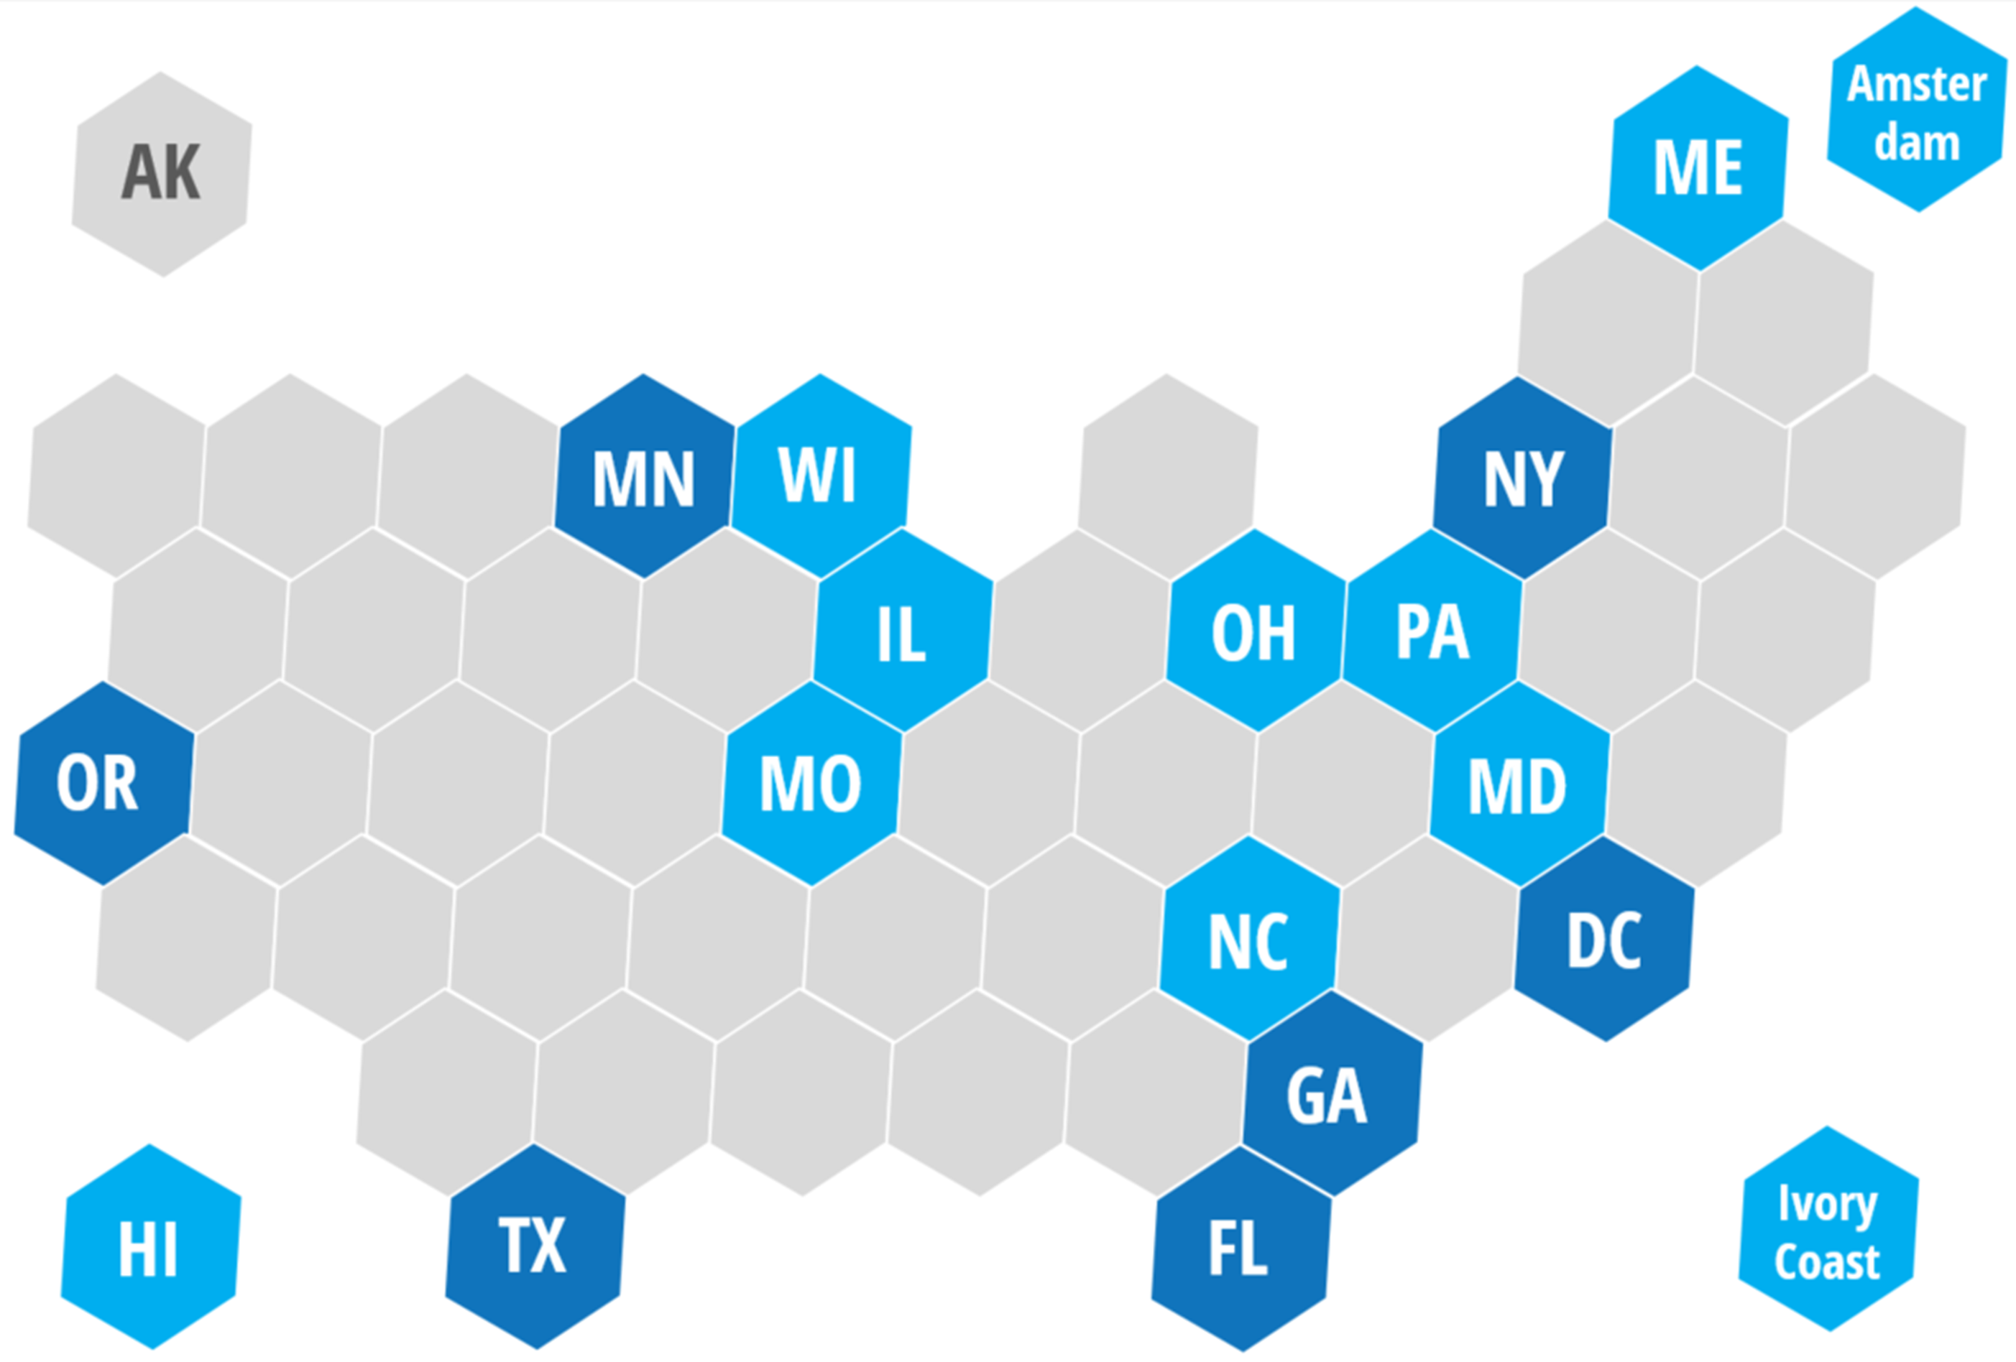
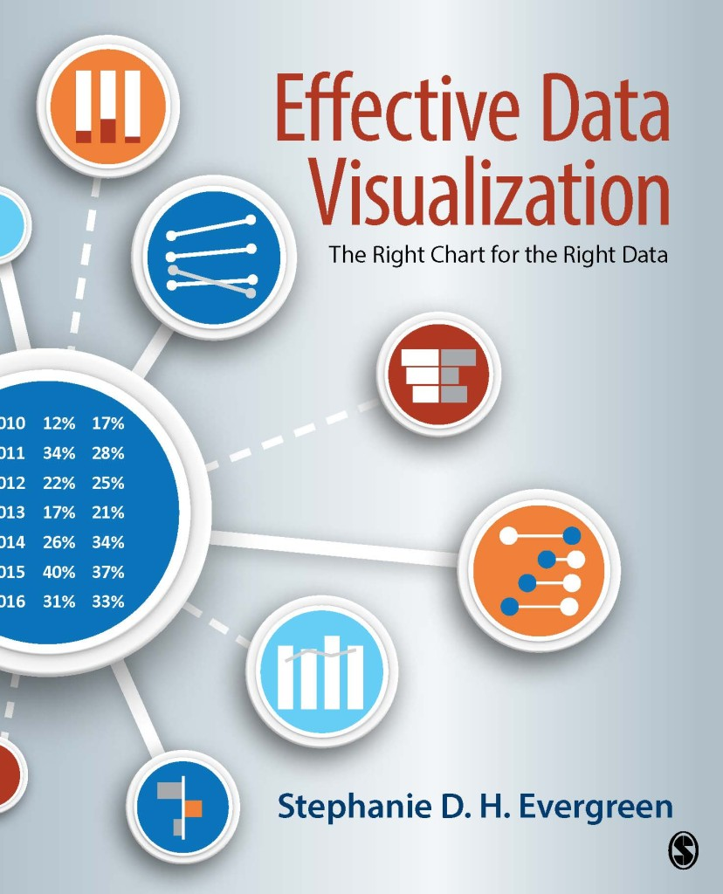
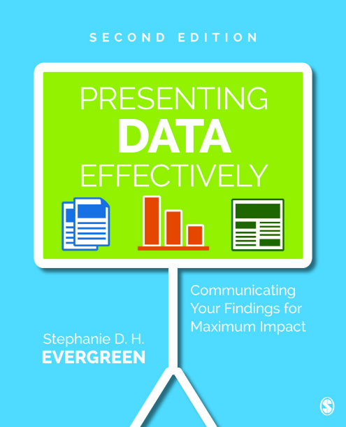
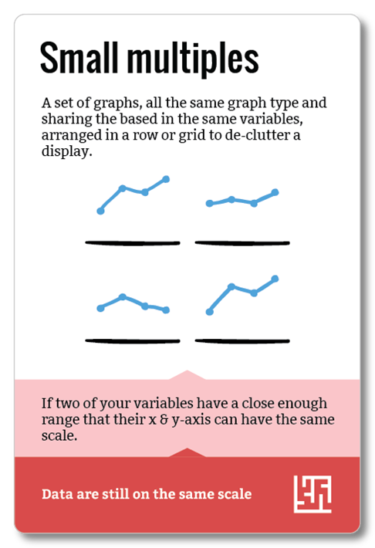
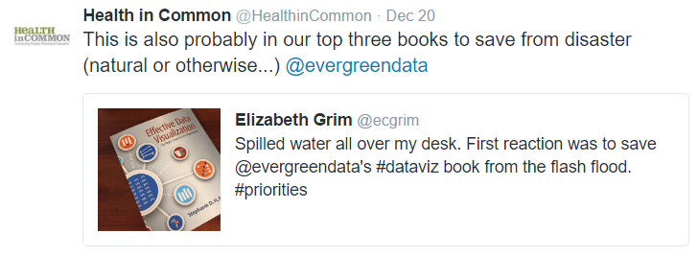
STEPHANIE EVERGREEN’S 2016
Personal ANNUAL REPORT
Blog views
learning to vacation
Most viewed post
Qualitative Chart Chooser
Places I traveled
Miles flown
118,247 (like AK to HI 43 times)
Books
Published May 2016
Data Visualization Academy
347 members & growing
Wrote 2nd edition Out May 2017
Workshops
Chart Chooser Cards
Tweets
1,035
more miles & fewer workshops means more exotic locations ;)
Mainly Wednesdays and at 9am Fave tweet about me:
Weird thing
1
# of times I ate octopus:
& never again.
Keep it weird, Portland.


Slide 2
STEPHANIE EVERGREEN’S 2016
Personal ANNUAL REPORT
Blog views
learning to vacation
Most viewed post
Qualitative Chart Chooser
Places I traveled
Miles flown
118,247 (like AK to HI 43 times)
Books
Published May 2016
Data Visualization Academy
347 members & growing
Workshops
Wrote 2nd edition Out May 2017
Chart Chooser Cards
Tweets
more miles & fewer workshops means more exotic locations ;)
1,035
Mainly Wednesdays and at 9am Fave tweet about me:
# of times I ate octopus
1
& never again.

Keep it weird, Portland.

